Slide 1



Power Pills: Lesson 2
Model Driven Applications
Yasmin Sarbaoui, Rossella De Santis, Ariel Tagliacozzo TS Power Platform
Clarissa Molfino, Bizz App PDM
Antonio Iodice, CSM Bizz App
Luca Costa, PTS

Slide 2
Content and Timeline Details
Check point & Certification Exam Prep
Complex
Basic
FROM BASIS
TO END-TO-END SOLUTION
Lesson 1
Common Data Service
13/01/2020
Lesson 2
Model Driven Apps
27/01/2020
Lesson 3
Canvas Apps
10/02/2020
Lesson 4
Advanced Capabilities
24/02/2020
Lesson 5
Power Automate
09/03/2020
Lesson 6
Power BI
23/03/2020
Lesson 7
Value Investment
06/04/2020

Slide 3

Previous Pill
Environment
Common Data Service + Common Data Model
Admin Centers
User + Security Roles
Solutions
Examples + Best Practices
Assignments
Q&A

Slide 4
Agenda
Entities + Relations
Keys
Business Process Flows
Model Driven Applications
Component Framework
Sample Data + Data Entry
Assignments
Q&A

Slide 5
Employee Check-out
HR App to manage the employee check out
Monitor the asset return
Differentiate the process depending on the user “type”

Slide 6

Entities
Notes:
How does an organization achieve that 30 percent savings? It’s through a combination of factors.
60 percent of all jobs have at least 30 percent of automatable activities.
Almost half of work activities have the potential to be automated using current tech.
And there’s huge opportunity in collecting and processing data through automation.

Slide 7
Entity Basics
Usually some form of interpretation of the real-life objects and concepts
Fields represent the individual data elements of an entity
Relationships connect entities
Permit
Inspections
Notes
Plans
Building Owners

Slide 8
Entity characteristics
System, Common Data Model, or Custom
Special types – Activities, Virtual Entities
Ownership – User/Team or Organization
Set of common fields
Notes:
Sometimes entities are created by system to support certain business functionality like BPF

Slide 9
Evaluating existing entity usage
  Are we using it for the intended purpose?
  What is the built-in functionality – do we need it, will it hurt us?
  Only reuse entities you know
  Do we have other future uses that might conflict?
  Should we create a type code vs. separate entity per type?
  Are there ISV solutions that depend on us using this entity?
Notes:
Start Time xx:xx / Length: 2 minutes
Review the learning objectives.

Slide 10
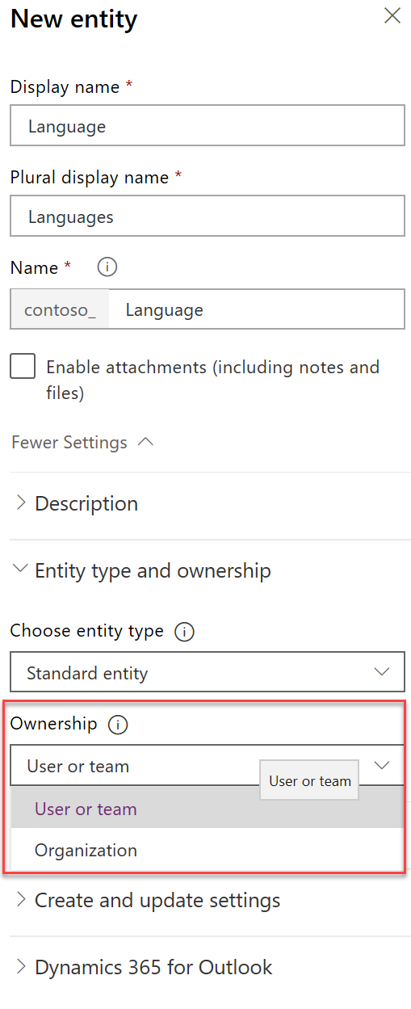
User/Team vs. Organization
All records have an owner
Organization
Supports access levels
Record owned by organization
All or nothing access
User/Team
When in doubt, choose User/Team
Organization is great for reference data

Slide 11
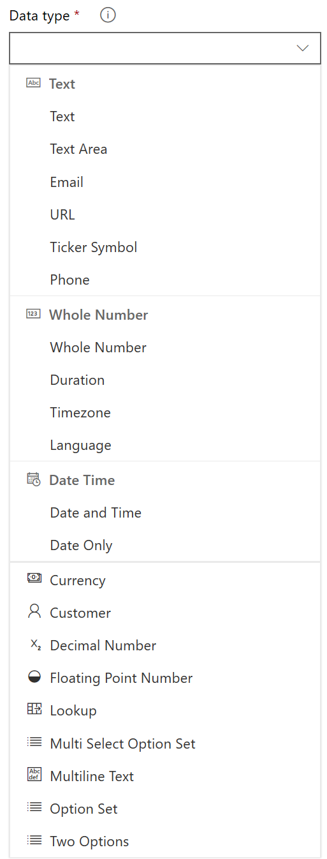
Fields
Data type and formatting
Can’t be changed after creation
Can be calculated or rolled up
System fields
Notes:
System fields
Createdon/by
Modifiedon/by
Owner (if user-owned)
Status / status reason
Special fields like Regarding on activity
Adding some type of fields create more than one, e.g. adding a first currency creates 3 fields

Slide 12
Option Sets vs. Lookup
Option sets
Only stores label and value
Lookups
Can store other data
Localization built-in
Filtered by developer script
Treated as solution component
No built-in way to retire
UX works to about 400 items
Stores as whole number
You build localization
Filter by views and security
Treated as reference data
Supports inactive state
UX scales to lots of items
Stores as entity reference
Notes:
Storing other data allows access when running workflows, or other customizations that reference the data. For example a related property can be used if a check condition
By being a solution component, option sets handle merge resolution by prefixing the value with the publisher prefix, optionsets require system customizer access, lookup fields can be changed by the non customizer if granted permission
UX for option sets is ideal for small quantity but doesn’t work well for large, lookups provide search type features not available on option sets
Dependent optionsets vs dependent (filtered) lookups
List of countries is a very good debatable topic in this instance
Another alternative to consider is a simple text field using the type-ahead lookup

Slide 13
Calculated vs. Rollup
Calculated
Calculated on retrieve of record
Read only field
Record fields and parent fields
Can include rollup fields in calculation
No OOB calculated fields
Rollup
Value stored on record, scheduled update/on-demand
Read only field
1:N only, fields on child records
Can rollup calculated fields
Can use hierarchy of related records
Can filter across related entities
Notes:
You can rollup "simple" calculated fields, e.g. calculated fields that include non-deterministic functions cannot be rolled up

Slide 14
Relationships
Venue
(primary)
N:N
Events
Contacts
1:N
Hidden Intersect Entity
1:N
1:N
Events
(related)

Slide 15
One-to-many relationships
One record of a primary entity
Zero, one, or many records of a related entity
Related entity has a lookup field
N:1 is a reverse 1:N relationship
Venue
(primary)
1:N
Events
(related)
Notes:
One-to-many (1:N) relationships are the most common type of the relationships found in Common Data Service for Apps.
For example, one venue can hold multiple events, or one company can have multiple employees.
Each one-to-many relationship has the following characteristics:
One record of a primary entity
Zero, one, or many records of a related entity
Related entity has a lookup field to store unique identifier of a primary entity.
N:1 is not a separate type, it is a 1:N relationship viewed from the other side

Slide 16
Many-to-many relationships
Many-to-many (N:N) is symmetrical
Hidden intersect entity created
Two 1:N relationships
Intersect entity cannot be customized
  Can be used by report designers and developers
N:N
Events
Contacts
Hidden Intersect Entity
1:N
1:N
Notes:
1:N (one-to-many) entity relationships establish a hierarchy between records. With N:N (many-to-many) relationships there is no explicit hierarchy. There are no lookup fields or behaviors to configure. Records created using N:N relationships can be considered peers and the relationship is reciprocal.
For example, one Event can have multiple attendees (contacts) and each contact can attend multiple events

Slide 17
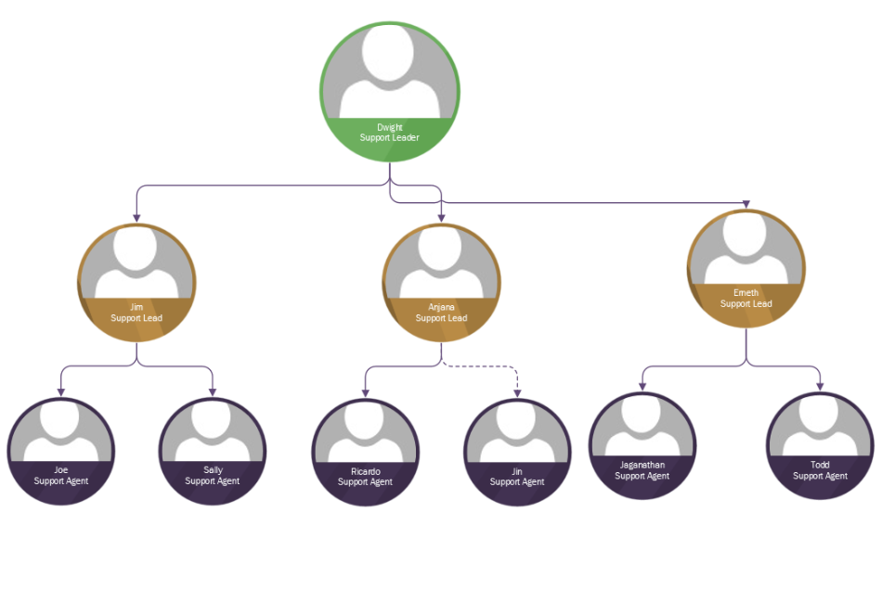
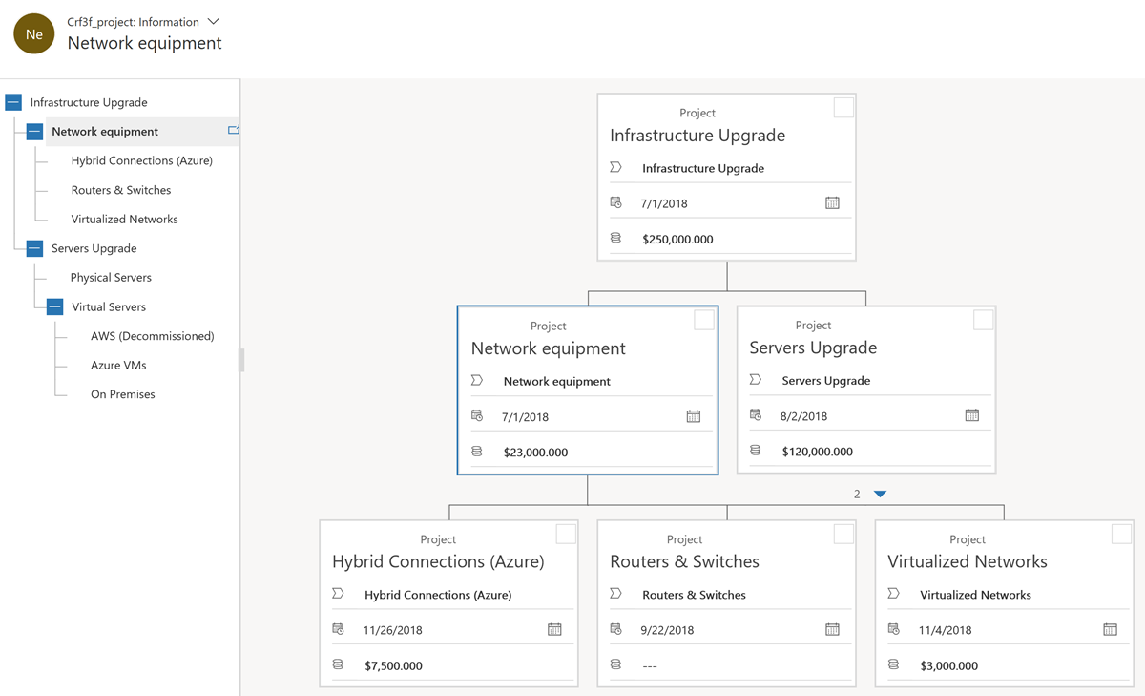
Hierarchical relationships
Visualize hierarchical data in model-driven apps
Use self-referential relationships to define a hierarchy
Notes:
Sometimes you need to relate records of the same type, for example company might have subsidiaries, employees report to their managers who report to theirs, and so on.
These relationships are called self-referential.
When you define these relationships, it’s often useful to represent the data as a hierarchical relationship, for example, as an organizational chart.
Common Data Services for Apps allow to define self-referential relationship as a hierarchical and visualize them in the model-driven apps

Slide 18
Connections are another option
Contact
John
Connection Role
Connection Role
English
German
Contact
Mary
Connection Role
Spanish
Connection Role
Notes:
Connections entity is shared, one security model for all uses
Any attributes added or form changes would be available for all uses of connections
User experience for connecting the records is clunky without custom UX like Opportunity has for Stakeholders

Slide 19
Data Entry + Sample Data

Slide 20
Keys
Notes:
How does an organization achieve that 30 percent savings? It’s through a combination of factors.
60 percent of all jobs have at least 30 percent of automatable activities.
Almost half of work activities have the potential to be automated using current tech.
And there’s huge opportunity in collecting and processing data through automation.

Slide 21
CDS uses a GUID as the primary key
When would an alternate key be helpful?

Slide 22
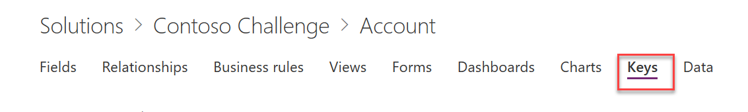
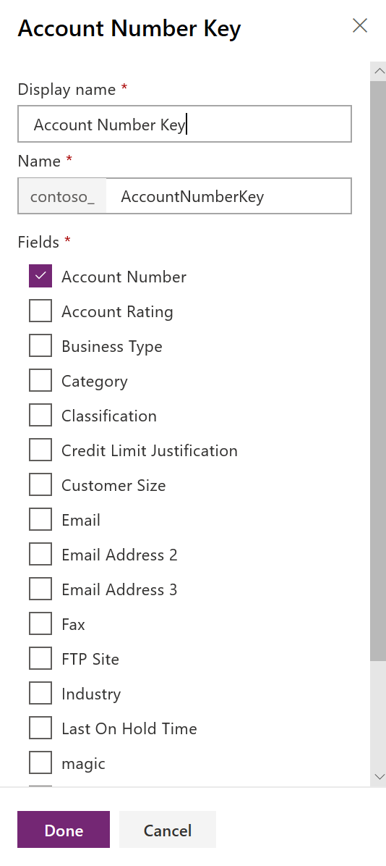
Alternate Keys
Create alternate keys containing decimal, whole number and string fields
Version 9.x and later can now also handle dates and lookup fields
Entities can have up to 5 alternate keys
Index is created behind the scenes to enforce uniqueness
Great for use in retrieves and updates
Notes:
When a key is created, the system validates that that key can be supported by the platform, including that the total key size does not violate SQL-based index constraints like 900 bytes per key and 16 columns per key
Attributes used must be “writeable”, e.g. OwningBusinessUnitId (Lookup type) won’t work
No FLS
Watch out for <,>,*,%,&,:,\\ - patch and upsert won’t work

Slide 23
Business Process Flows
Notes:
How does an organization achieve that 30 percent savings? It’s through a combination of factors.
60 percent of all jobs have at least 30 percent of automatable activities.
Almost half of work activities have the potential to be automated using current tech.
And there’s huge opportunity in collecting and processing data through automation.

Slide 24
Business Process Flows
Encourage outcomes, not wizard data capture
Link between related or unrelated entity types, automatic form transition
Amplifies change to form approach
Triggers automation based on progression
Now automatable with CRM 2015
Notes:
Seamless transition through multiple related entities without interruptions in UX.

Slide 25
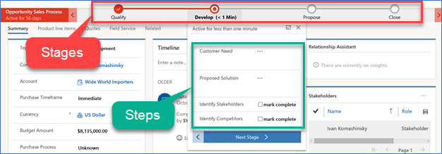
Business Process Flows
A guide, roadmap,
recipe, …
Stages and steps
Stage gating
Conditional
branching
Include multiple entities
Switch at any time
Role tailored
Automation and Developer APIs
Notes:
Spend as much time as necessary making sure the audience has an understanding of the basics of Business Process Flows

Slide 26
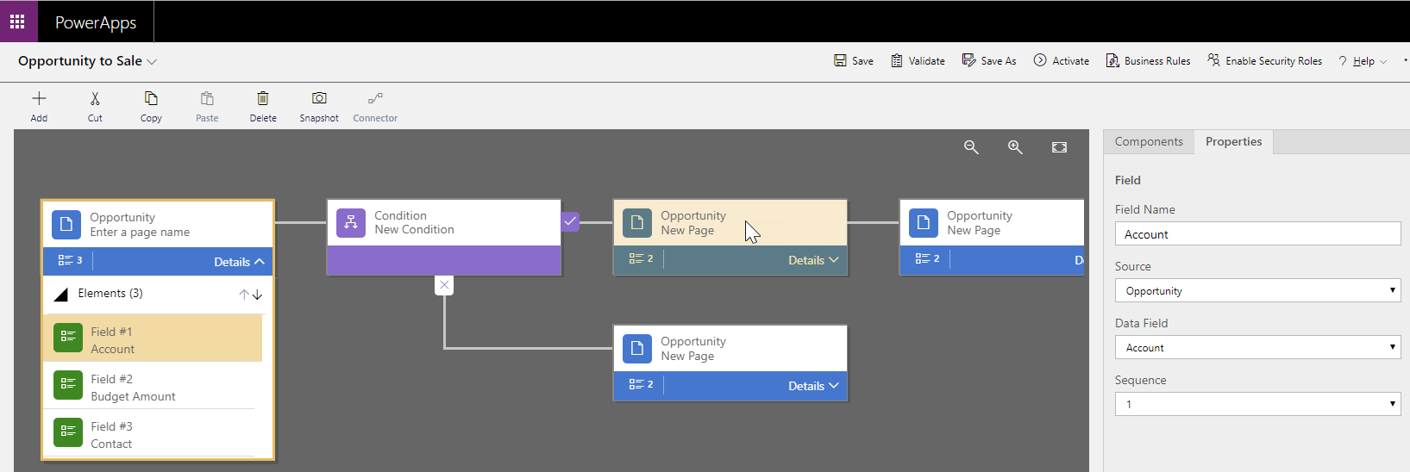
Creation and Configuration
Notes:
Custom business process flows as well as the configuration of system business processes are done using a drag and drop menu. You will decide which fields make up the steps, which steps are required, and which steps make up a stage.
You will also be making decisions about conditional branching and/or whether or not to associate multiple entities with your business process flow.
You will need to keep security roles in mind when configuring your business process as you may associate business process flows with security roles so that only people with those security roles can see or use them.
Although the business process flow control in the form does not provide any direct client-side programmability, changes applied by business rules or form scripts are automatically applied to business process flow controls. If you hide a field in a form, that field will also be hidden in the business process flow control. If you set a value by using business rules or form scripts, that value will be set within the business process flow.

Slide 27
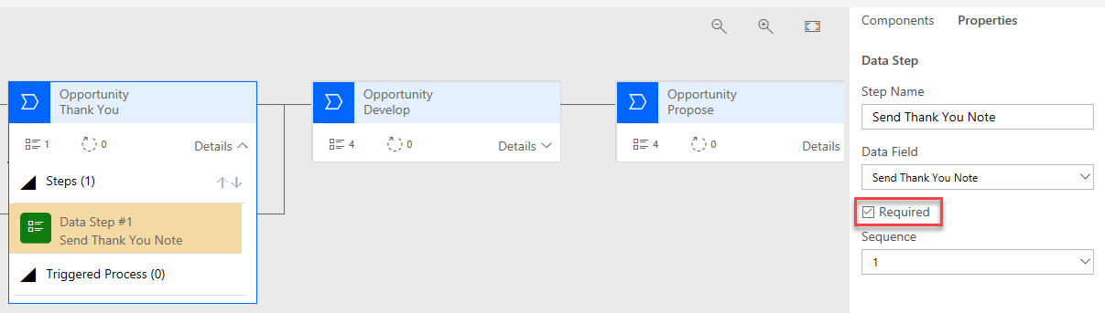
Configuring a Business Process Flow
Notes:
We learned about the many options to consider when configuring a Business process flow.
We learned about Branching, which may be used as a simple decision point of where an additional stage is added for some records or where the process splits into two distinct processes. In more complex scenarios there may be multiple levels of branching, for example where answering yes to a condition starts a stage and answering no presents another condition.
We discussed configuring a business process flow which spans multiple entities.
Another consideration we discussed was Stage Gating. Since a business process flow stage is comprised of steps and users advance to the next stage by clicking the next stage button, If any of the steps within a stage are designated as required these steps will prevent the user from clicking the next stage button. This is a way to enforce that a defined business process is followed.
We learned how to associate business process flows with security roles so that only people with those security roles can see or use them. You can also set the order of the business process flows so that you can control which business process flow will be set by default. This works in the same way that multiple forms for an entity are defined.
Lastly, we looked at Custom Controls…
To wrap up, we spent some time practicing by working with Business Process Flows in a hands on lab.

Slide 28
Model Driven Applications

Slide 29
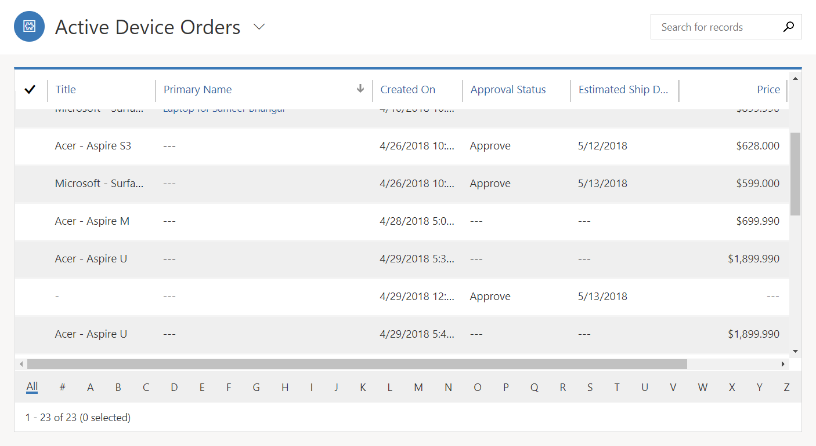
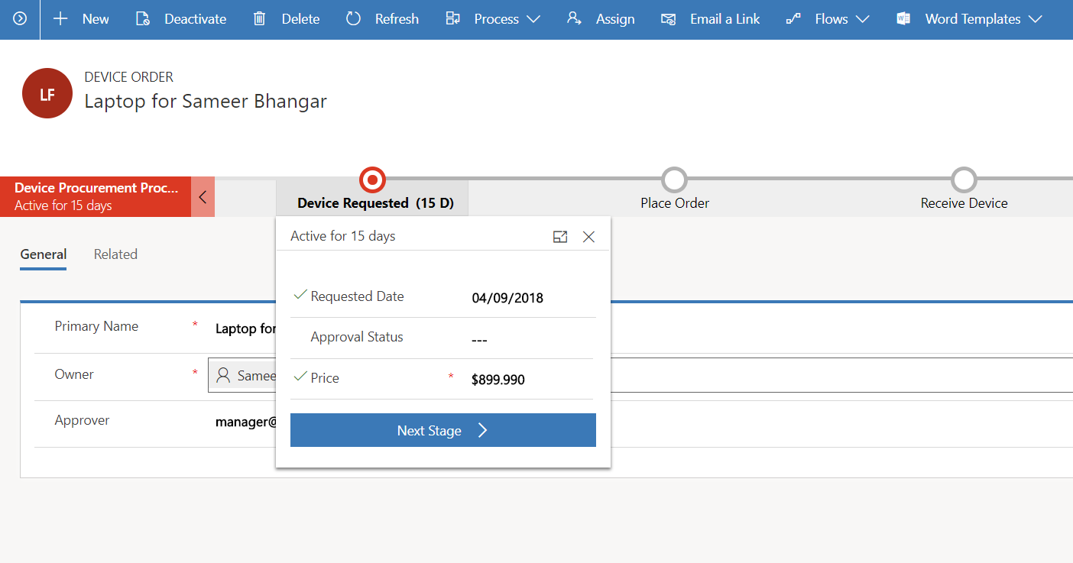
Model-driven Apps
List and forms over data
Consistent experience across apps and devices
Easy to build with configuration first approach
Notes:
Start Time xx:xx / Length: 2 minutes
Review the learning objectives.

Slide 30
Built-in to all model-driven apps
Advanced Find
Searching
Personal Views
Personal Dashboards
Editable Grids
Excel Integration
Client Dev Extensibility
Client side Business Rules
Reusable Quick View Forms
Business Process Control
Timeline Activity View
Command Bar Extensibility
Merging of Form Changes
Multiple Makers
Recently Viewed/Pinned
Localization support
Notes:
Multiple Makers – Canvas apps can only have one person editing at a time, Model-driven apps can have multiple makers working on different parts of the app
Strong ISV ecosystem of model-driven apps
Full support of solutions

Slide 31
Components of a model-driven app*
Views
Forms
Related Entities
App
Navigation
Command Bar
Business Process
Dashboards
Lists
Quick Views
Charts
*all this and more
Notes:
These are some of the key components that make up the overall user experience.
By customizing these we create the flow that takes a user through a business activity such as updating locating and updating a contact, or resending an updated quote
Dynamics 365 Navigation and Dashboards often offer entry points for users to drill deeper and complete a business activity. Dashboards often times offering a quicker path to an individual record
Quick View and Business Process Flows help blend the user’s perception of where one record starts and another picks up. Helping to improve the flow as you work with multiple entities.
This is a simplified view of the experience, adding things such as web resources can add infinitely more layers to the experience, good and bad

Slide 32
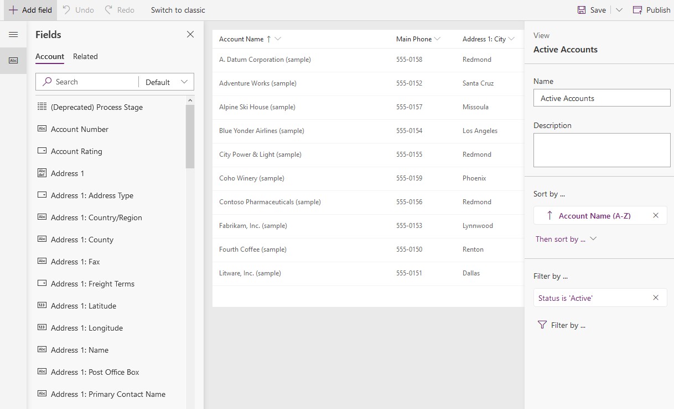
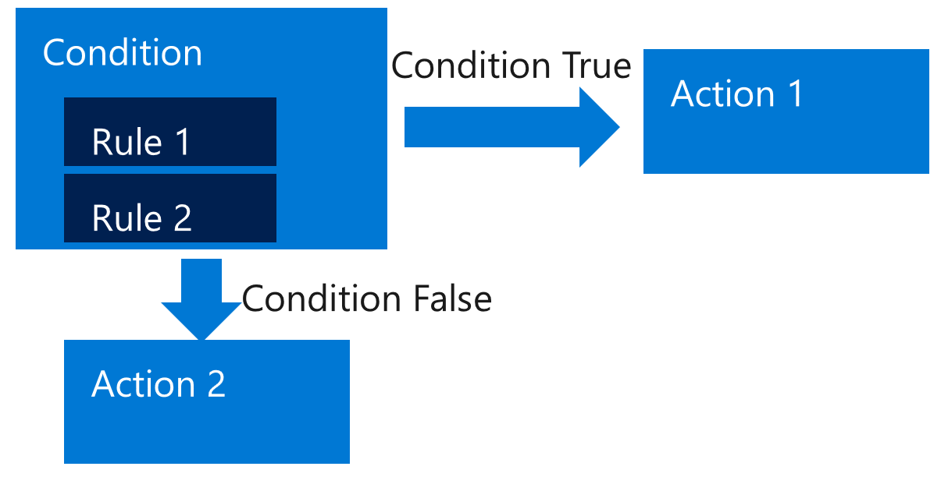
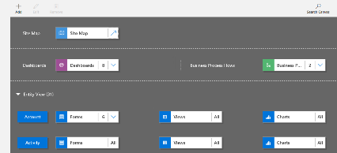
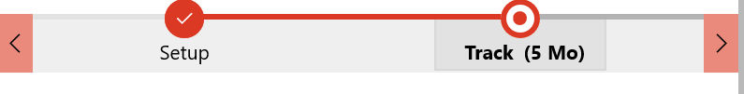
From zero to model-driven app
Build the Data Model
Create Forms, Views and Dashboards
Compose the App
Build Business Rules
Build Process Flows
Permit
Inspections
Notes
Plans
Building Owners

Slide 33
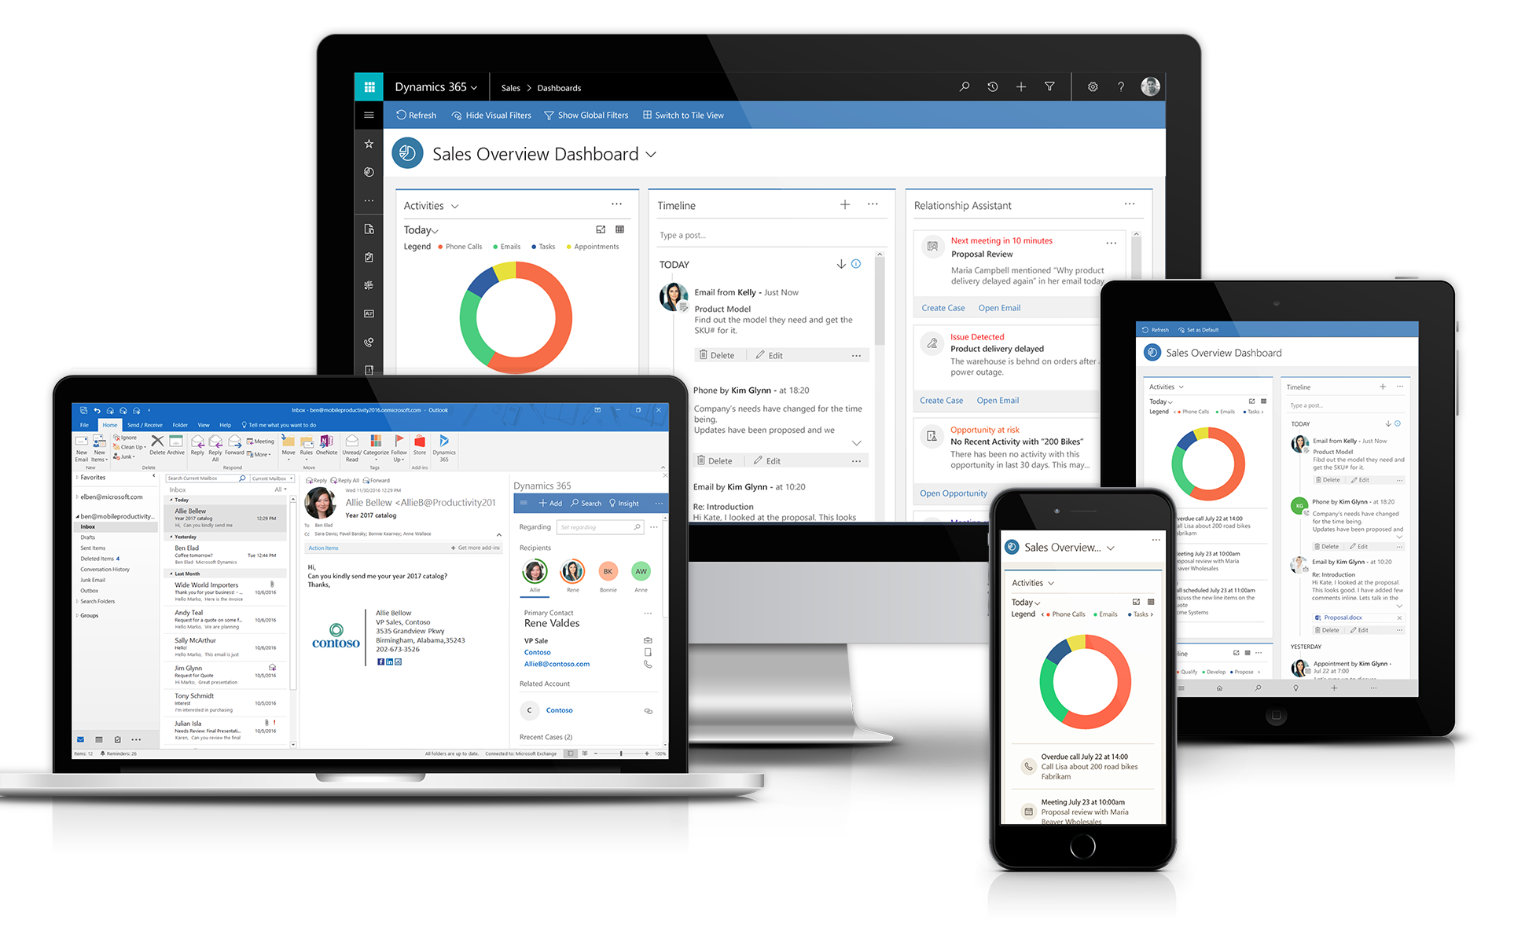
Unified Interface
Consistent responsive experiences
Consistent and equivalent functionality across all surfaces – web, mobile and Outlook. Including native RTL support across all devices
Focused and modular experience
Application Module concept available across all form factors. Scenario focused, Easy to build and shareable micro applications
Custom controls
Rich visualization through custom controls adapts across all form factors provides reuse and better productivity
Performant
Efficient metadata synchronization for better performance and continued investments to improve speed across client experiences
Accessible
Built from ground up with Accessibility in mind
Enhanced experiences
Additional dashboarding and PowerBI capabilities and enhanced user interactions for mobile and desktop usage.
Notes:
Capabilities
Interactive Dashboards
New Rich Chart Types
Full sitemap with quick access to favourites and MRU
Semantic Zoom
Relevance Search
Business process & docking

Slide 34
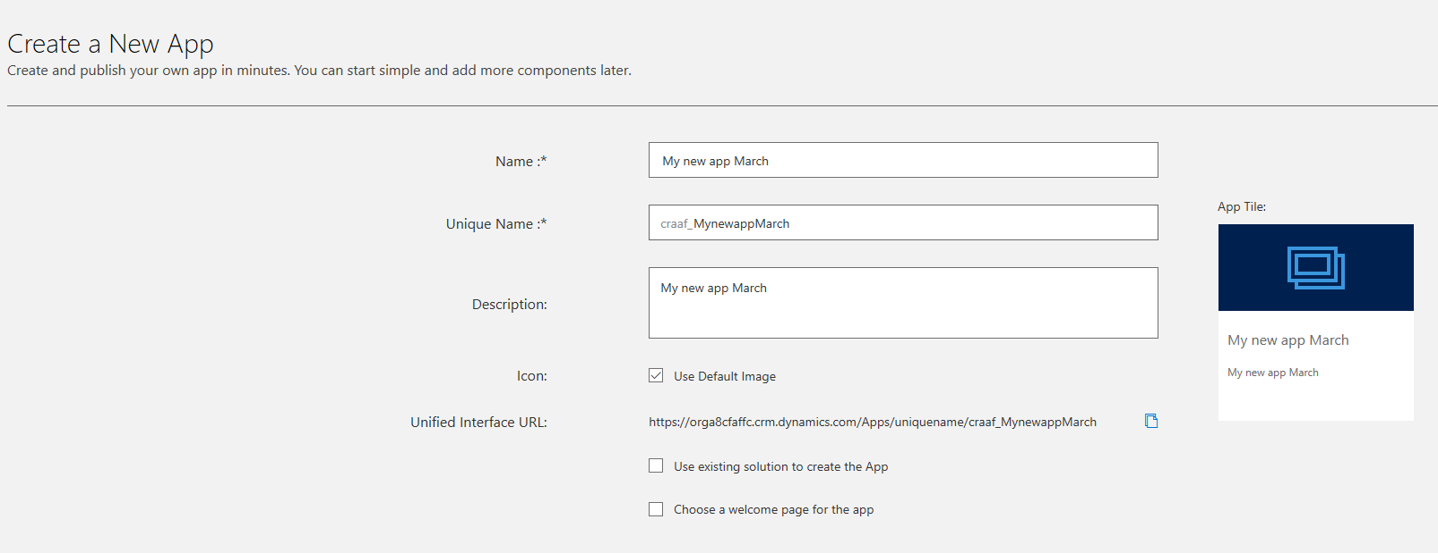
Composing Apps

Slide 35
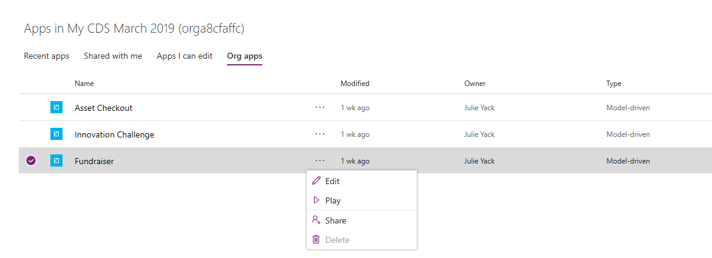
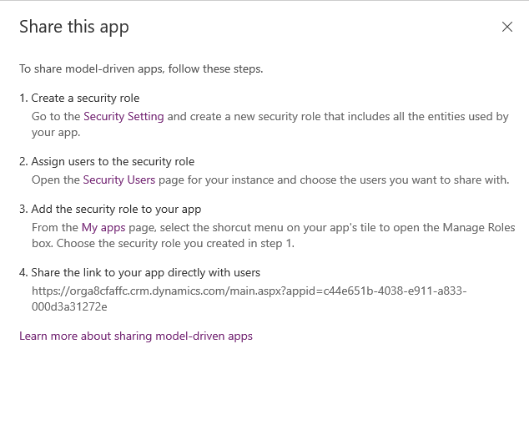
Controlling who can use App Modules
Notes:
Remember apps are not a security feature in themselves. E.g. I can fire up advanced find and open an account even if account is not included
Start Time xx:xx / Length: 2 minutes
Review the learning objectives.

Slide 36
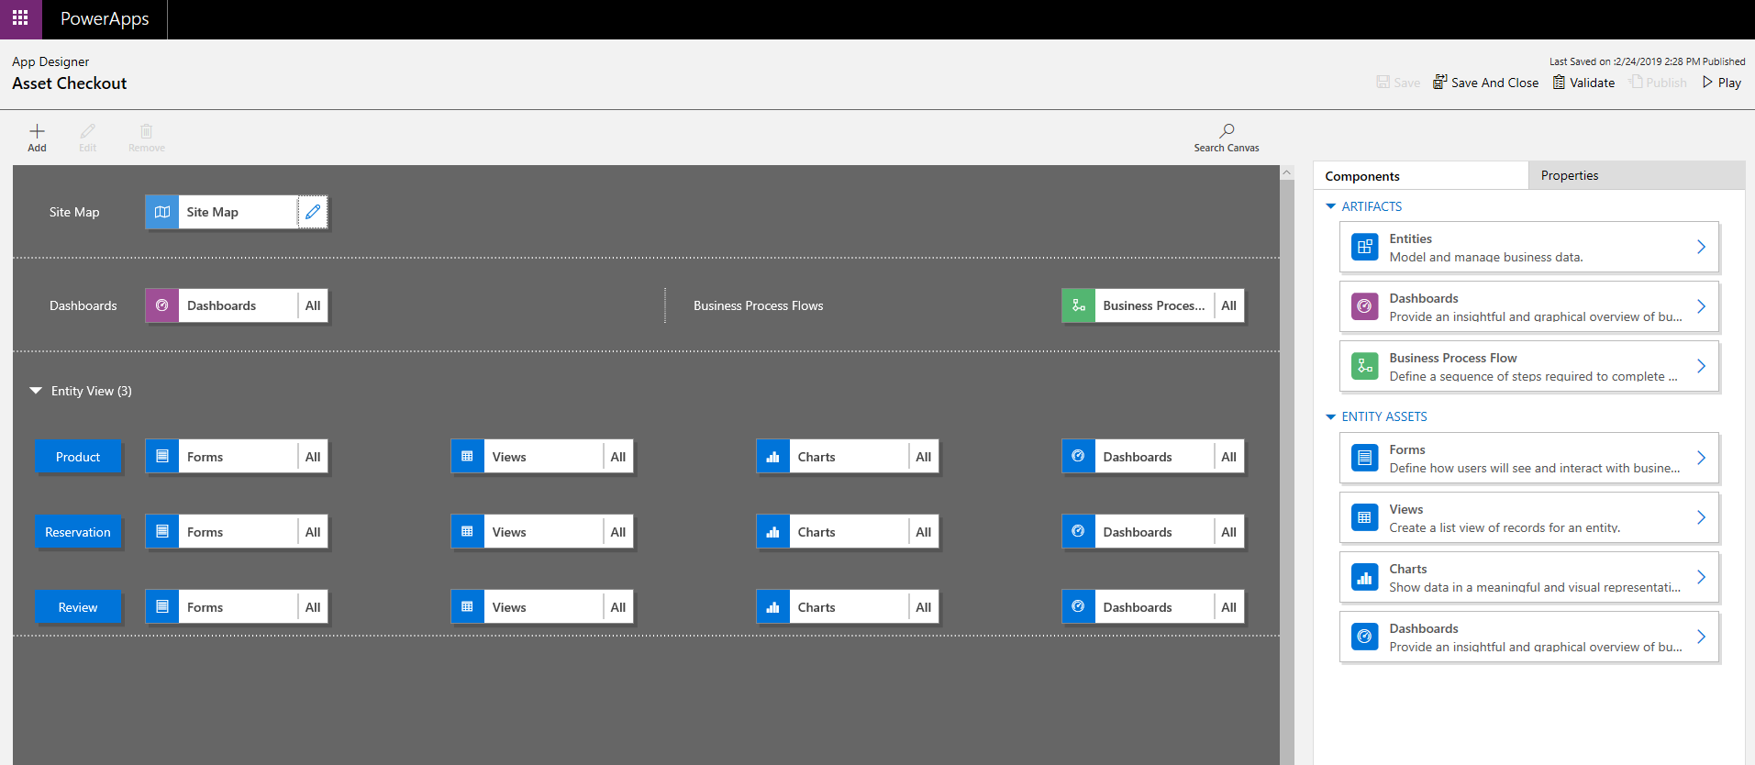
Working with the App Designer

Slide 37
Customizing Navigation
Customize by changing the SiteMap
Navigation is a result of the merged SiteMap from all solutions
Area and groups are containers
Subareas point to entity , web resource or URLs
Security will trim items, can also trim by removing item
Site Map Structure
Area
Group
Group
Subarea
Subarea
Subarea
Subarea
Area
Group
Group
Subarea
Subarea
Subarea
Subarea

Slide 38
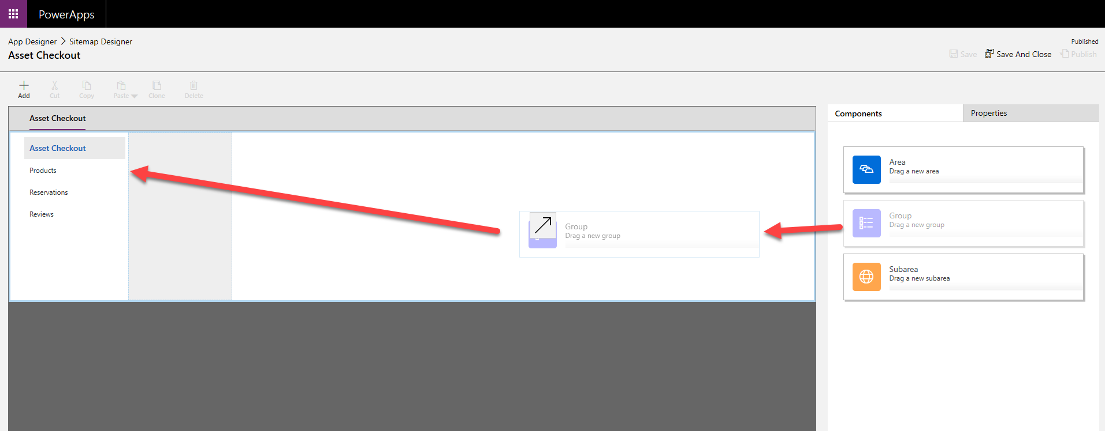
Working with the Site Map Designer

Slide 39
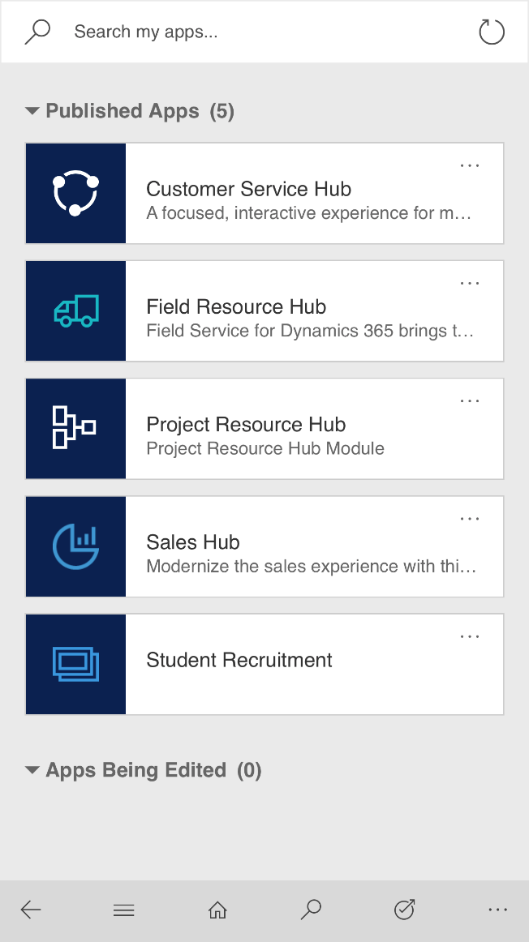
Key Features
Unified Interface on Mobile
Full sitemap on Mobile
Responsive UI
Semantic Zoom
Interactive Dashboards
Reference Panel
Timeline Control
Record set navigation
Visualization
Accessibility
Removed limits: 75 fields, 10 sub grid and tabs
And more…

Slide 40
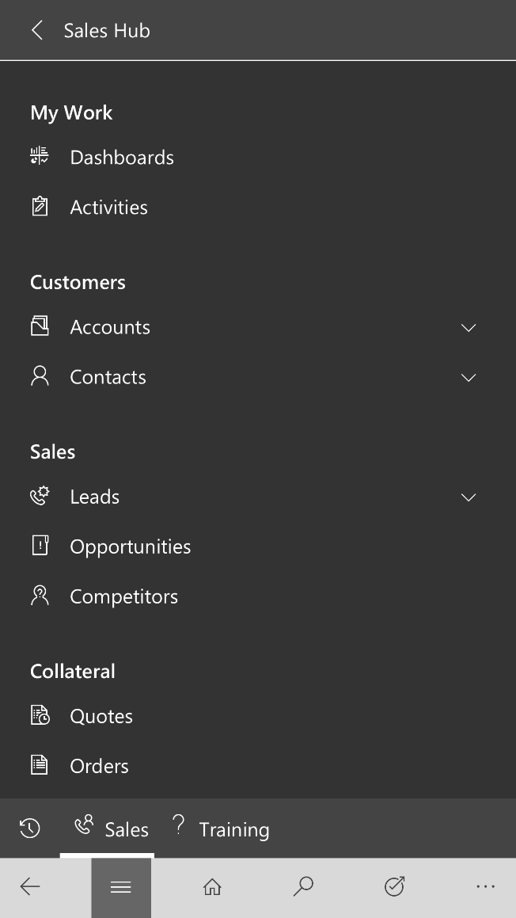
Key Features
Unified Interface on Mobile
Full sitemap
Responsive UI
Semantic Zoom
Interactive Dashboards
Reference Panel
Timeline Control
Record set navigation
Visualization
Accessibility
Removed limits: 75 fields, 10 sub grid and tabs
And more…

Slide 41
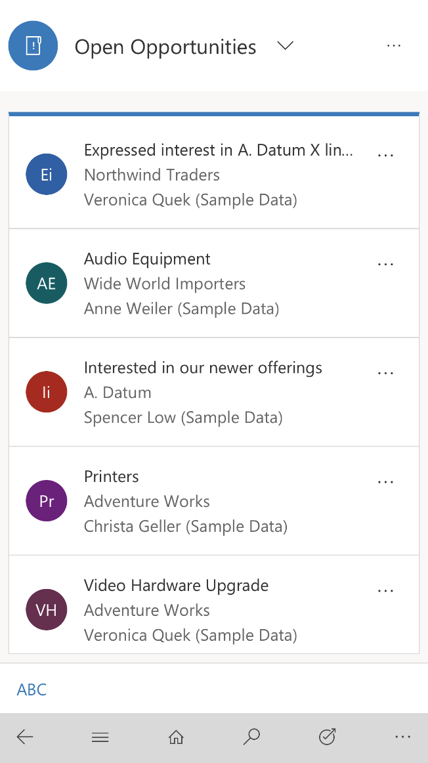
Key Features
Unified Interface on Mobile
Full sitemap on Mobile
Responsive UI
Semantic Zoom
Interactive Dashboards
Reference Panel
Timeline Control
Record set navigation
Visualization
Accessibility
Removed limits: 75 fields, 10 sub grid and tabs
And more…

Slide 42
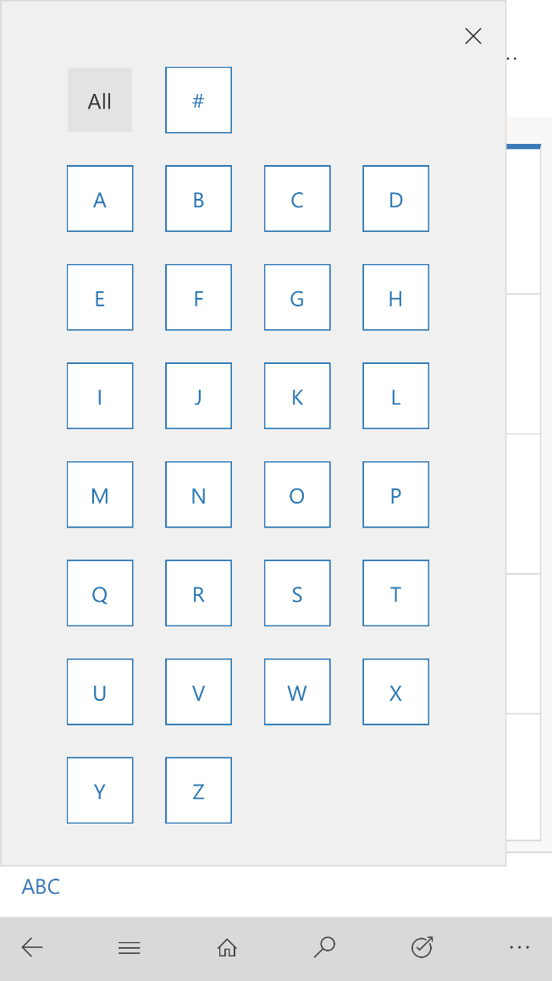
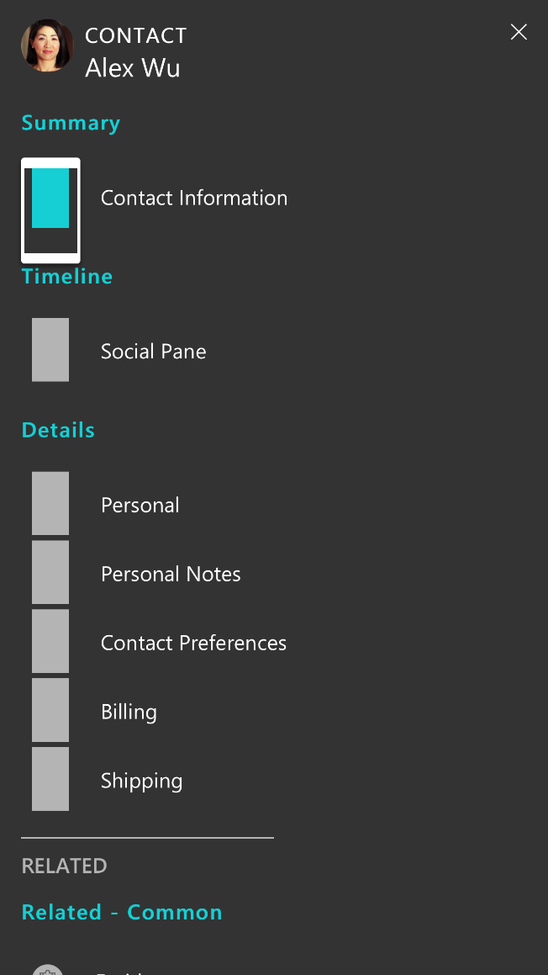
Key Features
Unified Interface on Mobile
Full sitemap on Mobile
Responsive UI
Semantic Zoom
Interactive Dashboards
Reference Panel
Timeline Control
Record set navigation
Visualization
Accessibility
Removed limits: 75 fields, 10 sub grid and tabs
And more…

Slide 43
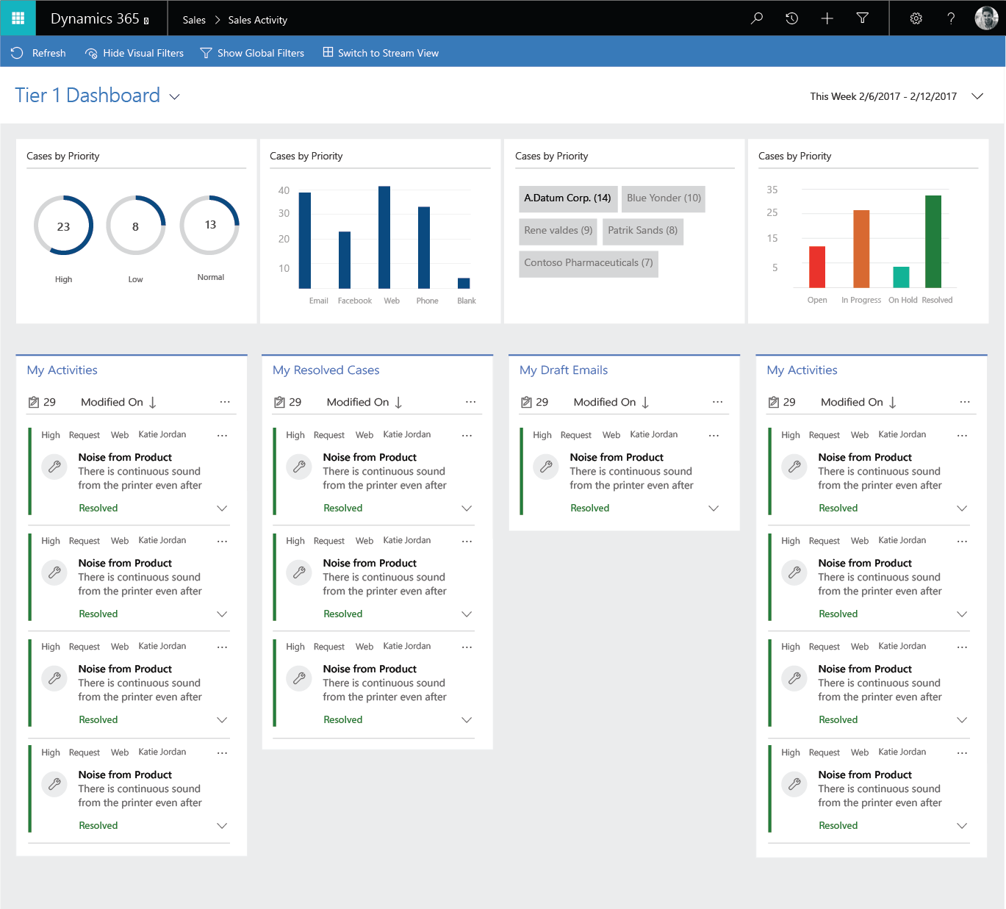
Key Features
Unified Interface on Mobile
Full sitemap on Mobile
Responsive UI
Semantic Zoom
Interactive Dashboards
Reference Panel
Timeline Control
Record set navigation
Visualization
Accessibility
Removed limits: 75 fields, 10 sub grid and tabs
And more…

Slide 44
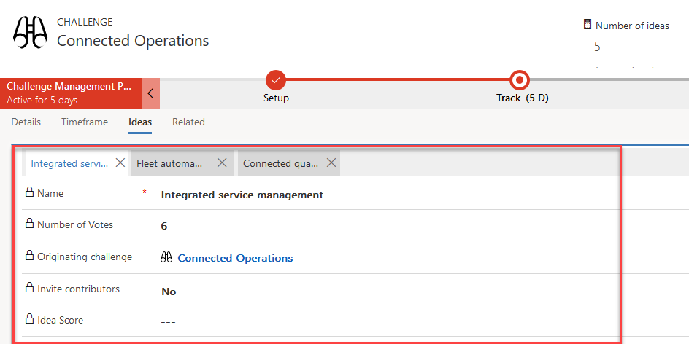
Key Features
Unified Interface on Mobile
Full sitemap on Mobile
Responsive UI
Semantic Zoom
Interactive Dashboards
Reference Panel
Timeline Control
Record set navigation
Visualization
Accessibility
Removed limits: 75 fields, 10 sub grid and tabs
And more…
Notes:
One per form, great when you want to have multiple views of different child records and switch between their quick views

Slide 45
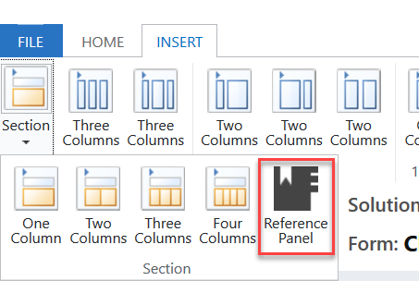
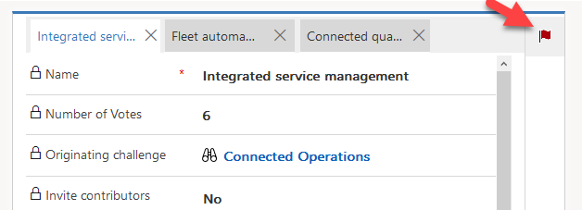
Reference Panels
One per form, configured like a section with a sub grid
Requires a quick view
Allows opening multiple records
Notes:
One panel per form, multiple sub-grids per panel
Will prompt to open full record if no quick view configured
Can configure subgrid to render using a custom control
No ability to specify which quick view will be used

Slide 46
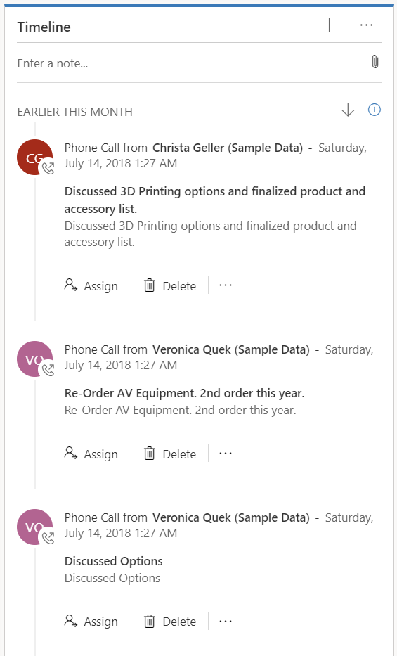
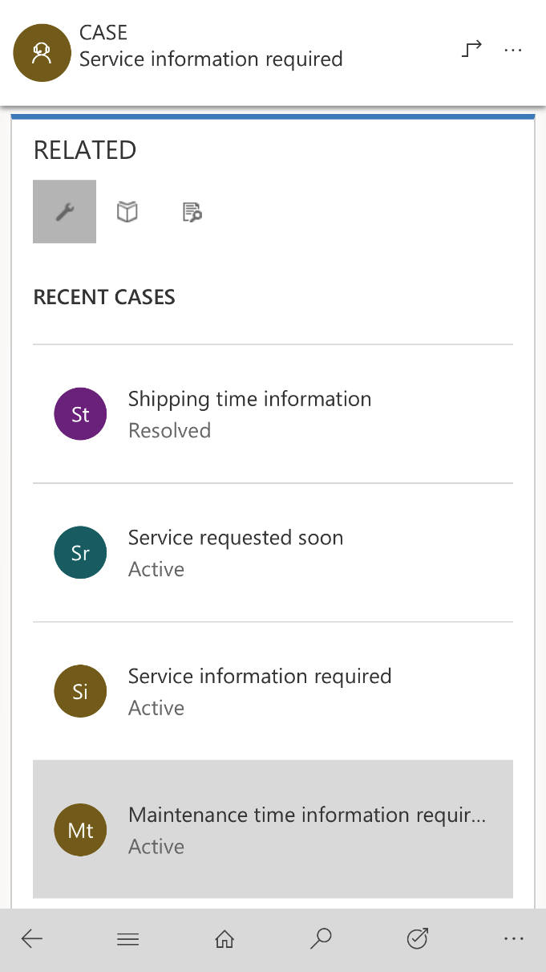
Key Features
Unified Interface on Mobile
Full sitemap on Mobile
Responsive UI
Semantic Zoom
Interactive Dashboards
Reference Panel
Timeline Control
Record set navigation
Visualization
Accessibility
Removed limits: 75 fields, 10 sub grid and tabs
And more…

Slide 47
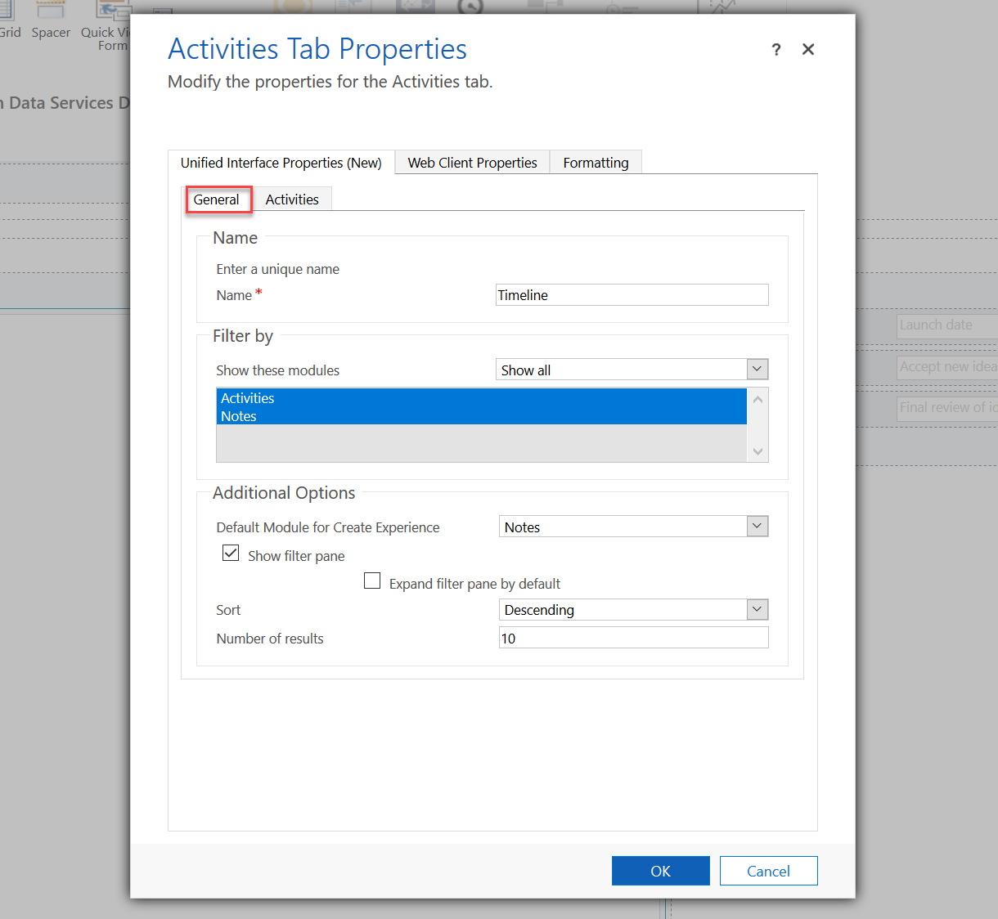
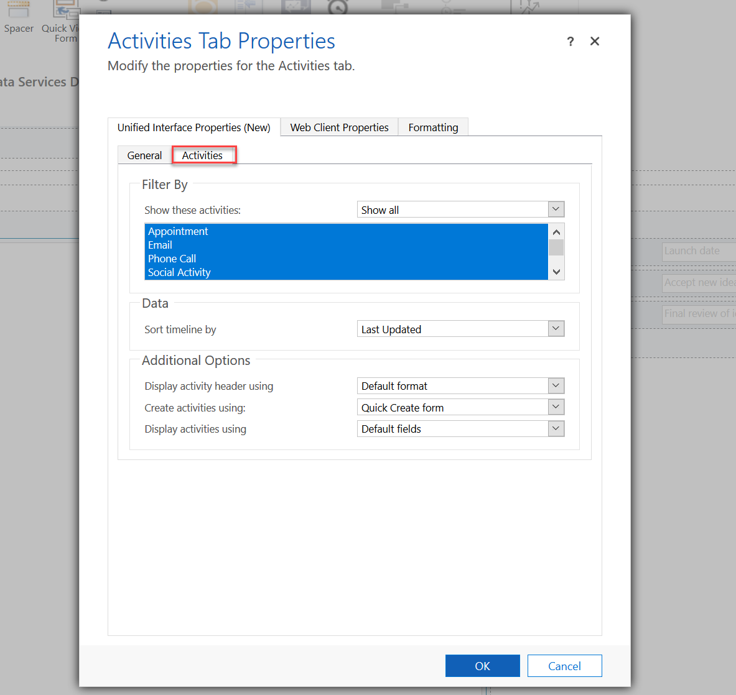
Configuring the timeline control

Slide 48
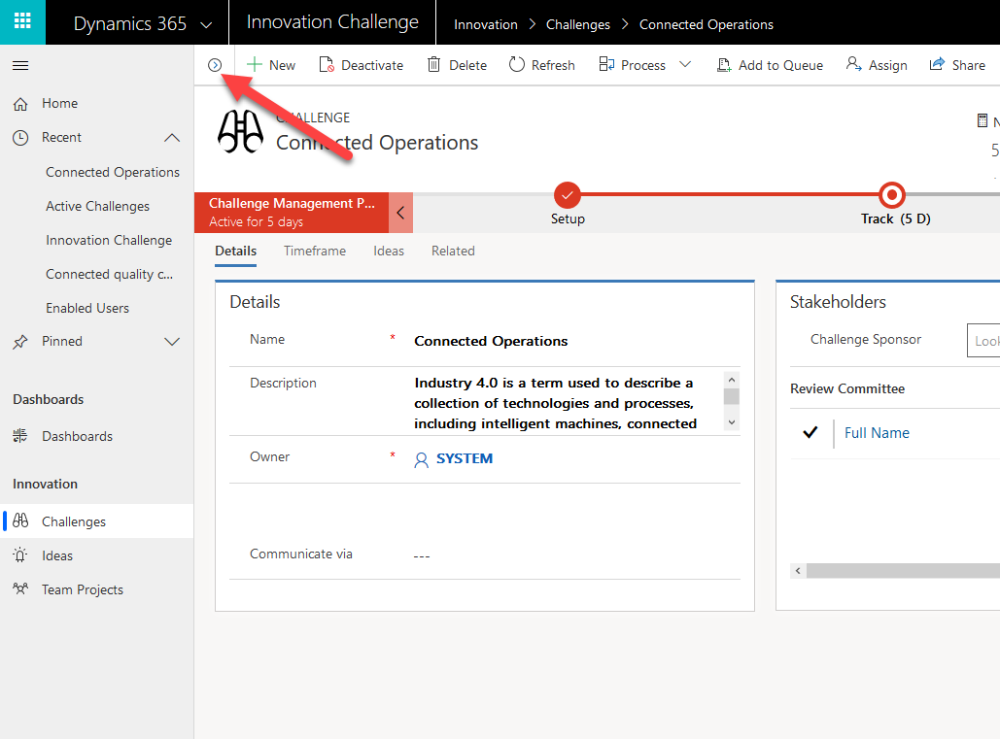
Key Features
Unified Interface on Mobile
Full sitemap on Mobile
Responsive UI
Semantic Zoom
Interactive Dashboards
Reference Panel
Timeline Control
Record set navigation
Visualization
Accessibility
Removed limits: 75 fields, 10 sub grid and tabs
And more…

Slide 49
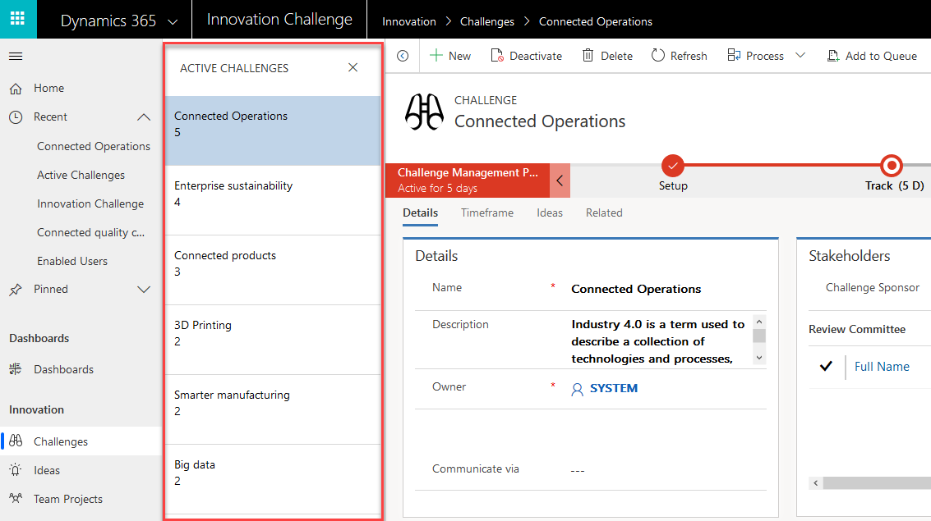
Key Features
Unified Interface on Mobile
Full sitemap on Mobile
Responsive UI
Semantic Zoom
Interactive Dashboards
Reference Panel
Timeline Control
Record set navigation
Visualization
Accessibility
Removed limits: 75 fields,
10 sub grid and tabs
And more…

Slide 50
Model-driven form types
Main
Quick View
Quick Create
Card

Slide 51
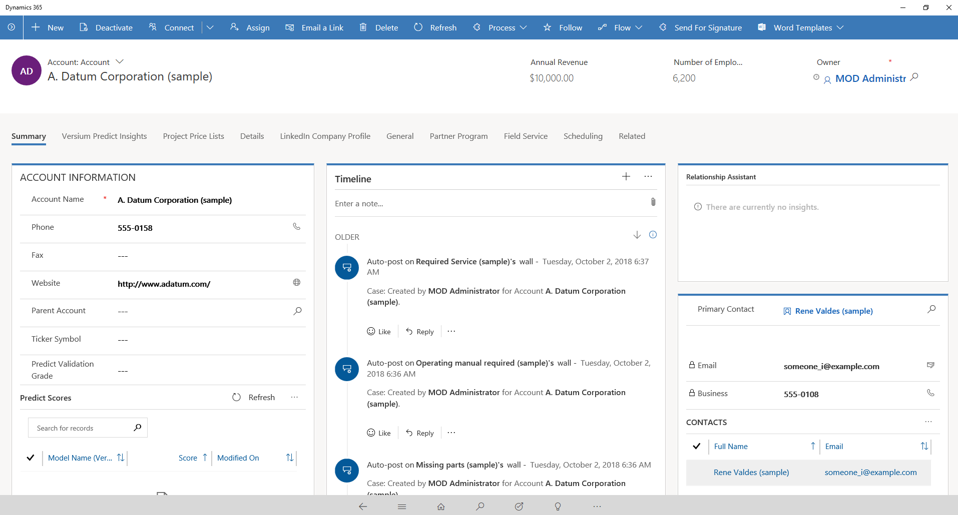
Form Types - Main
Notes:
Main
Main forms are the primary user interface where people view and interact with their data. Main forms provide the widest range of options and are available for model-driven apps,
One of the primary design objectives for main forms is that you design them once and deploy them everywhere. The same main form you design for a model-driven app or the Dynamics 365 customer engagement web application, is also used in Dynamics 365 for Outlook and Dynamics 365 for tablets.
The advantage to this approach is that you don’t have to integrate changes into multiple forms.

Slide 52
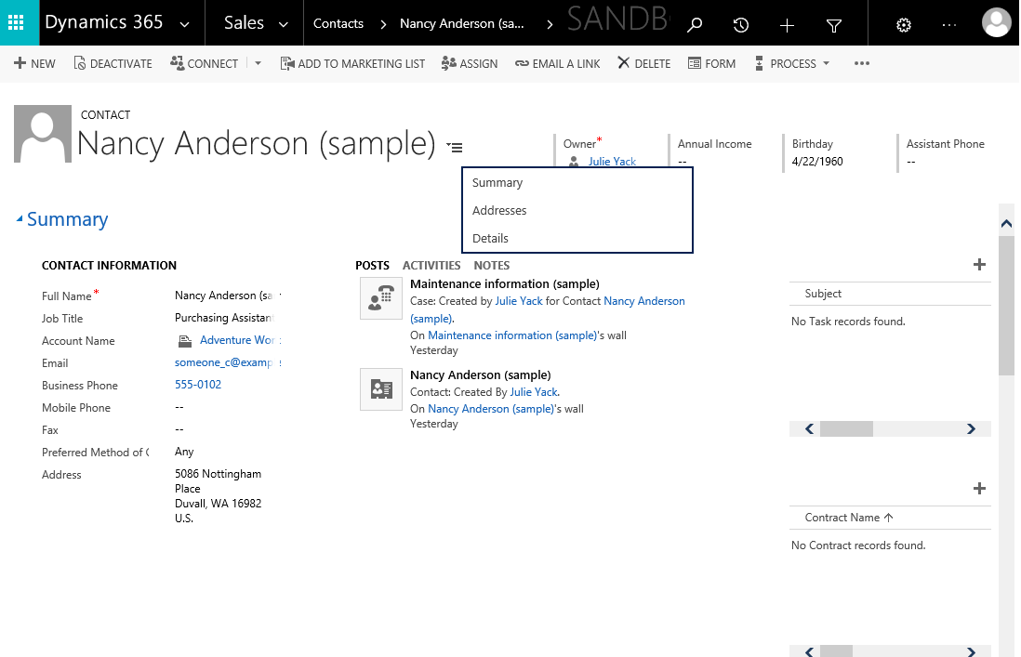
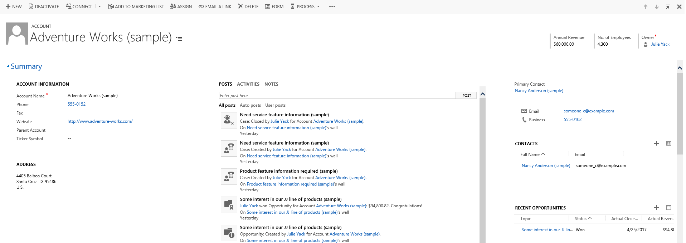
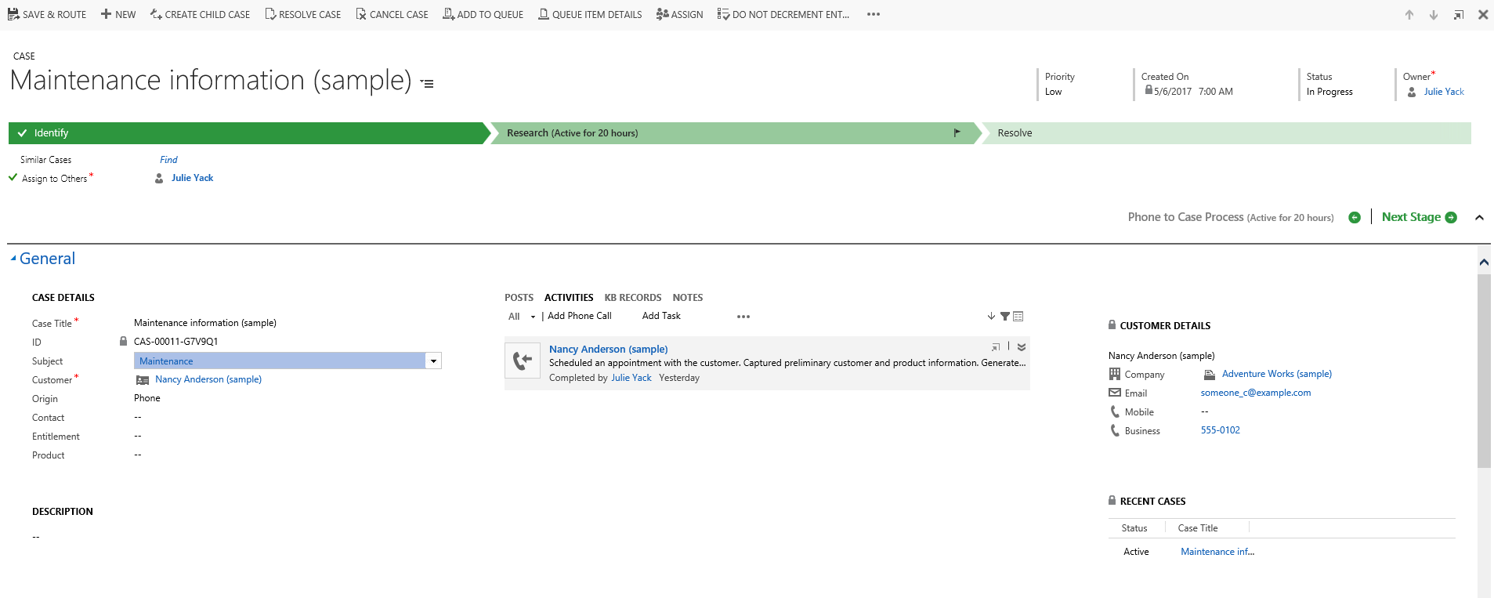
Sub grids on forms
Related Record
Back
Use sub grids and lookups to provide natural flow of information discovery and consumption
Ensure key information on sub grid e.g. opportunity owner
Natural flow back to original context also
Can be editable
Related Record
Back

Slide 53
Form Types – Quick View
Notes:
Quick View - Used in PowerApps apps, the Dynamics 365 web application, Dynamics 365 for Outlook, and Dynamics 365 for tablets.

Slide 54
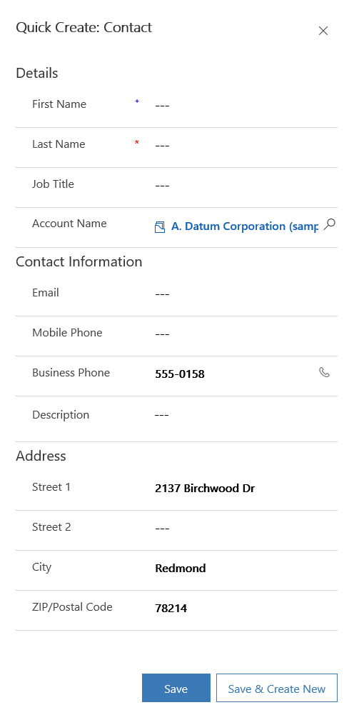
Form Types – Quick Create
This was launched from an account form
Common data has been mapped
User to add additional information
Retains relationship to entity of origin when launched from there
Possible to launch independent of related entity- starts with no mapped data or relationships
Notes:
Once you launch, you can now add a new record
Quick Create - Used in PowerApps apps, the Dynamics 365 web application, Dynamics 365 for Outlook, and Dynamics 365 for tablets.
With quick create forms, your app can have a streamlined data entry experience with full support for logic defined by form scripts and business rules.
In Dynamics 365, quick create forms appear when you select the Create button in the navigation bar or when you choose + New when creating a new record from a lookup or sub-grid.
The Dynamics 365 customer engagement mobile apps use quick create forms for creating new records. If an entity already has a quick create form configured for it, the mobile apps use that form. If an entity doesn't have a configured quick create form, Dynamics 365 generates a quick create form for creating records in the mobile apps based on the main form definition.

Slide 55
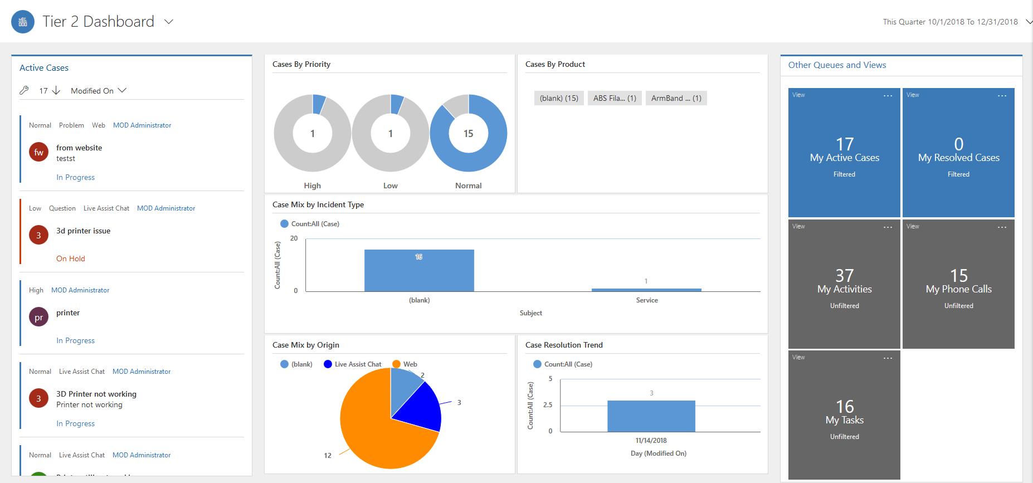
Form Types – Card
Notes:
A card can be placed on the record of a related entity or on an interactive dashboard. Starting at an interactive dashboard, we see the left column feed of active cases, each of those cases we see are being displayed on a Card form. Let’s look at one of them in more detail
Card – These forms are used in the interactive dashboards to show the entity data in the streams of interactive dashboards.
Note: These forms are only for use in the Customer Service Hub. You can’t use these in the Microsoft Dynamics 365 web application, Microsoft Dynamics 365 for Outlook and Microsoft Dynamics 365 for tablets.

Slide 56
Control availability for lists
Allows custom controls to customize the view of a list of records
Can also be used to visualize a sub grid on a form
Calendar
Timeline
Editable Grid
Read-only Grid

Slide 57
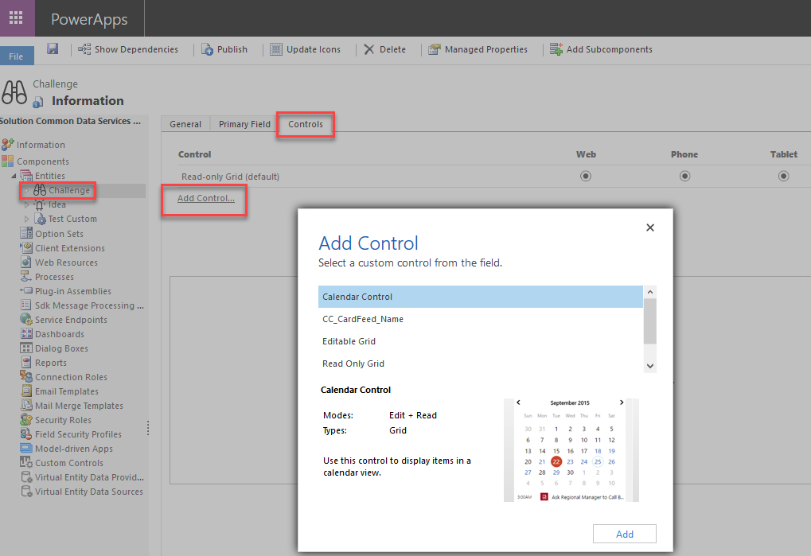
Configuring List Controls

Slide 58
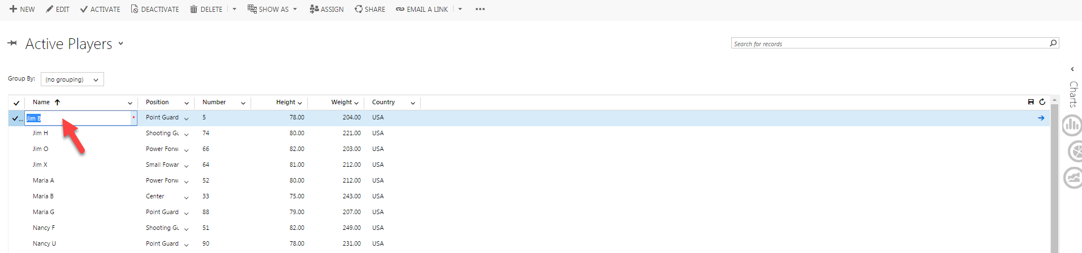
Editable grids
Available for grids and sub-grids on forms
Must be enabled
Allow inline editing and additional grouping choices

Slide 59
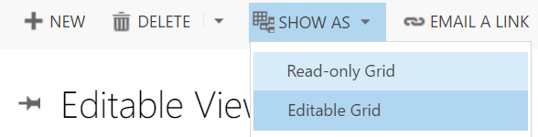
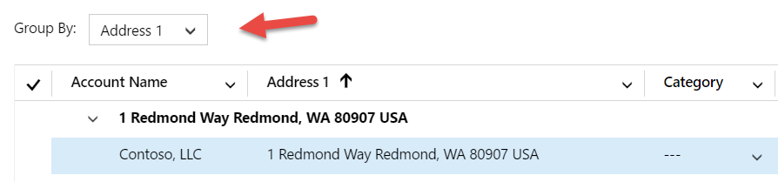
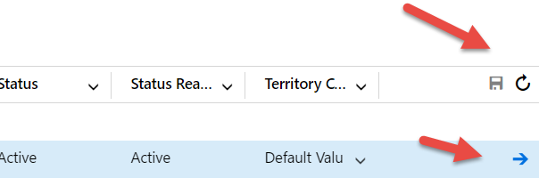
Using the editable grid

Slide 60
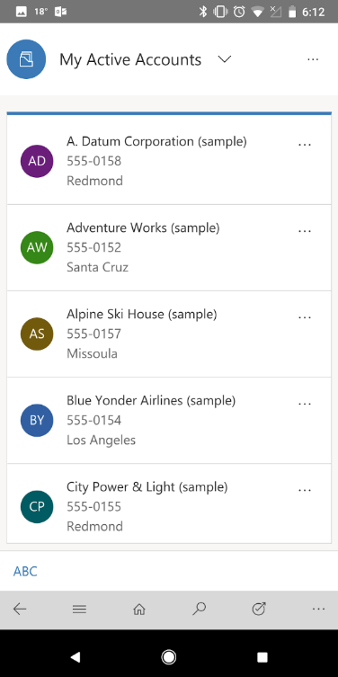
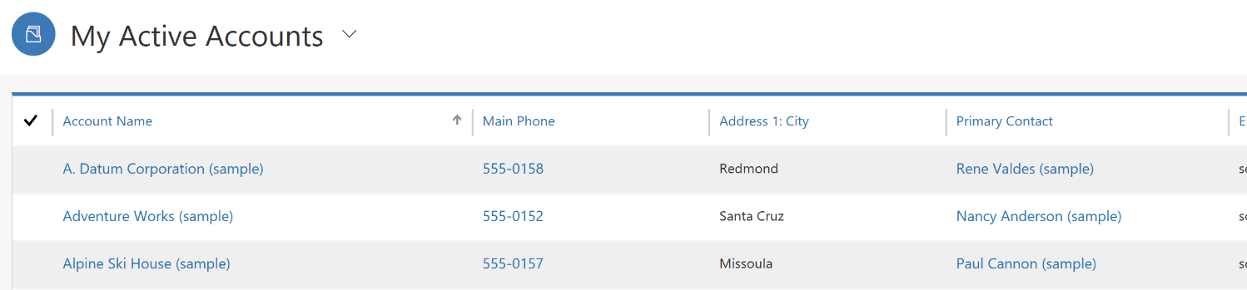
Working with Views
List View
Good views are essential for usability
View will reflow based on display size
Reflow behavior can be controlled
Grid View

Slide 61
Module Review
Model-driven apps provide the fastest path to getting an app up and running on CDS data
Unified Interface runtime provides a consistent and accessible user experience across apps and devices
Notes:
Start Time xx:xx / Length: 2 minutes
Review the objectives for this module.
Ask participants to use the Text tool to write on the screen if they had any questions about the module.

Slide 62
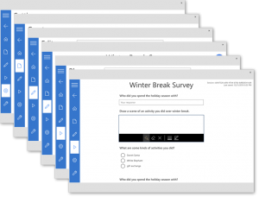

Types of components
Canvas Components
Power Apps Component Framework (PCF)
Targeted for canvas app makers
Works in canvas apps
Targeted for professional developers to build
Works in model-driven apps today, future will support canvas apps

Slide 63

Community Component Gallery
https://powerusers.microsoft.com/t5/Canvas-Apps-components-samples/bd-p/ComponentsGallery

Slide 64
PCF Overview
Power Component Framework – An extensibility framework for creating custom visuals for the professional developer.
  Authoring
  Packaging
  Installation
  Configuration
  Client Rendering
Value Proposition
  Power of using full HTML/Javascript to create truly custom UI
  Rich ecosystem of re-usable, accessible, and performant UI components
  Configurable by Makers
  Heavy-Lifting handled by the platform!
  Access to an extensive API Surface

Slide 65


Slide 66

What makes a component?
Manifest File
Component Implementation
Typescript or JavaScript
Resource Files
Control artifacts
Control definition
Name
User interface
JS Libraries
CSS
Localization
Properties
Resource files
Functionality
Images etc
Version
Sample PCF Component (code)

Slide 67
PCF Solution Import and CDS Tables
Power Control Framework Solution Components
PCF Control Definition
  CustomControl
  CustomControlResource
  WebResource
SystemForm – Form Configuration
CustomControlDefaultConfig – Entity Grid Configuration

Slide 68

PCF Control Configuration
In the Form Editor,
  Identify the field control you want to visualize.*
  Open the field’s Properties Dialog.
  Navigate to the ‘Controls’ tab
  On the ‘Controls’ tab, you can add and configure your control.
*The data type of the field control (entity attribute) must match the type of the property node in your control’s manifest.

Slide 69
Best Practices
Notes:
How does an organization achieve that 30 percent savings? It’s through a combination of factors.
60 percent of all jobs have at least 30 percent of automatable activities.
Almost half of work activities have the potential to be automated using current tech.
And there’s huge opportunity in collecting and processing data through automation.

Slide 70
Avoiding Common Data Modeling Issues
Too many entities, too many fields
Local option sets should not be used
Avoid two options, if there might be more
You are stuck with field formatting forever
Don’t build out parts of the data model you don’t plan to use
Notes:
Two Options - True / False, but then you realize you have to store Unknown vs. not provided
In the New admin experience Field Formatting is presented as different field types

Slide 71
Requirements
Environment: create Sandbox and Production Environment
Common Data Service: create database
Admin Centers: Assign licenses to users
User + Security Roles: Create at least two security roles
Solutions: create unmanaged solution to host the future deployment and install solution checker

Slide 72
Requirements
Entities + Relations: create at least 1 custom entity and relate it
Keys: (optional) assign a different key to one of the used entities
Business Process Flows: create one significant business process flow
Model Driven Applications: Design the application, customize the forms
Component Framework: (optional for developers) add a custom component
Sample Data + Data Entry: input data or add sample data

Slide 73

Link di registrazione per la prossima sessione già disponibile!

Slide 74
Q & A

Slide 75






THANK YOU
Contact us at: pwrpills@microsoft.com
Clarissa Molfino
Bizz App PDM
Luca Costa
PTS
Rossella De Santis
Power Platform TS
Antonio Iodice
Bizz App CSM
Yasmin Sarbaoui
Power Platform TS
Ariel Tagliacozzo
Power Platform TS

